Slide 1

Automotive Technology: A Systems Approach, 8e
Chapter 47: Steering Systems
Rob Thompson and Jack Erjavec, Automotive Technology: A Systems Approach, 8th Edition. © 2025 Cengage. All Rights Reserved. May not be scanned, copied or duplicated, or posted to a publicly accessible website, in whole or in part.

Slide 2
Chapter Objectives (1 of 2)
47.01 Identify the typical steering system components and their functions.
47.02 Identify the basic types of steering linkage systems.
47.03 Describe the function and operation of a steering gearbox and the steering column.
47.04 Perform general power-steering system checks.

Slide 3
Chapter Objectives (2 of 2)
47.05 Inspect and service steering linkage components.
47.06 Inspect and service power steering components.
47.07 Describe the components and operation of four-wheel steering systems.

Slide 4
Mechanical Steering Systems
47.01 Identify the typical steering system components and their functions.
Steering system is composed of three major subsystems.
  Steering linkage
  Steering gear
  Steering column and wheel

Slide 5
Parallelogram Steering Linkage
47.02 Identify the basic types of steering linkage systems.
Once the most common type.
Used with the recirculating ball gearbox.
Can be placed in front or behind the front suspension.
Provides good steering geometry.
Road vibrations and impact forces cause wear and looseness.

Slide 6
Rack-and-Pinion Steering Linkage
Lighter and has fewer components than the parallelogram linkage.
The rack performs as steering gear and center link.
Tie-rods are the only linkage used.
Provides better road feeling but can transmit more road shock.

Slide 7
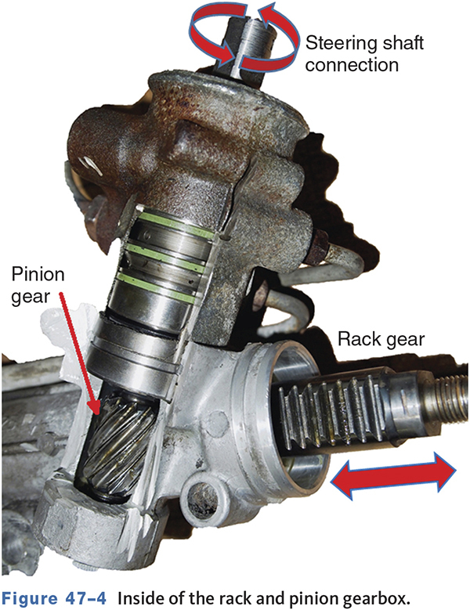
Rack-and-Pinion Steering (1 of 2)
Rack
  Is a toothed bar in a metal housing that acts similarly to a center link.
Pinion
  Is a worm gear attached to the steering column that transfers movement to the rack.

Slide 8
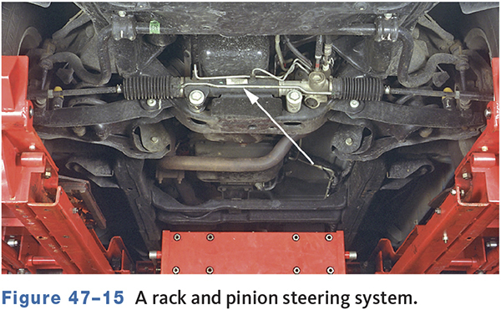
Rack-and-Pinion Steering (2 of 2)

Slide 9
Knowledge Check (1 of 3)
Which type of steering linkage is the most common on modern cars and light trucks?
  Parallelogram
  Rack and Pinion
  Cross link

Slide 10
Knowledge Check Answer (1 of 3)
Which type of steering linkage is the most common on modern cars and light trucks?
  Parallelogram
  Rack and Pinion
  Cross link
  Answer: Rack and Pinion

Slide 11
Rack and Pinion Advantages
A rack and pinion is lighter in weight and has fewer components than parallelogram steering.
In the rack and pinion steering arrangement, there is no Pitman arm, idler arm assembly, or center link.
The driver gets a greater feeling of the road with rack and pinion.

Slide 12
Steering Wheel and Column
47.03 Describe the function and operation of a steering gearbox and the steering column.
Provides the force to turn the steering gear.
Since 1968, all columns are collapsible.
Houses the driver side air bag.
May have tilt and/or telescoping features.
Houses many of the driver operated switches and sometimes the transmission shifter.

Slide 13
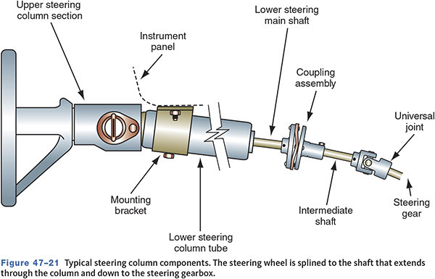
Steering Column Components

Slide 14
Power Steering Systems
Reduce driver effort.
Major types
    Hydraulic
      Hydraulic pressure is used to assist the driver.
    Electric
      Electric motors are used.

Slide 15
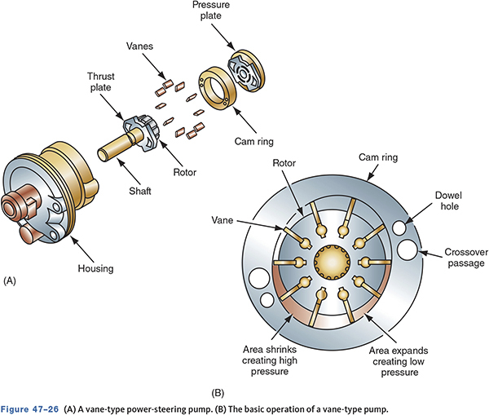
Power Steering Pump Types
Roller
Vane
Slipper
Gear

Slide 16
Power Steering Hoses
Transmit fluid from the pump to the gearbox and back to the pump.
Must handle pressures up to 1500 psi.
Subject to pressure and pulsations from the pump.
Must be able to withstand temperatures of up to 300°F (150°C).

Slide 17
Electronically Controlled Power-Steering Systems
Provides increased assist at low speeds and decreased assist at higher speeds.
The amount of fluid flow is controlled by a pressure control valve.
Uses input from Vehicle Speed Sensor.

Slide 18
Electric Power Steering (EPS)
Nearly all vehicles use electrically-assisted power steering.
The EPS motor may be column mounted or in the rack and pinion.
Allows for features such as parking assist and active steering control.
Provides power assistance even when the engine stalls, since the power source is the battery rather than the engine-driven pump.

Slide 19
Electric Rack and Pinion System
Replaces the hydraulic pump, hoses, and fluid.
An electric motor located with the rack provides assist and feedback.
Uses a steering wheel position sensor.
Provides assist if the engine stalls.

Slide 20
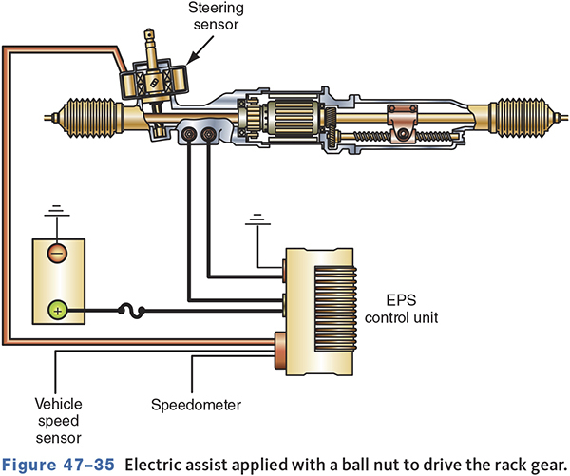
Electric Power Steering Rack and Pinion

Slide 21
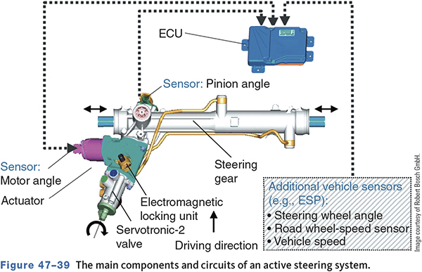
Active Steering System

Slide 22
Knowledge Check (2 of 3)
Which of the following is true of electric power steering systems?
The power assist motor can be integrated with the rack gear.
The assist motor may be located in the steering column.
The electric power steering (EPS) is also incorporated into the self parking system.
All of the above.

Slide 23
Knowledge Check Answer (2 of 3)
Which of the following is true of electric power steering systems?
The power assist motor can be integrated with the rack gear.
The assist motor may be located in the steering column.
The electric power steering (EPS) is also incorporated into the self parking system.
All of the above.
Answer: D. All of the above

Slide 24
Common Steering System Complaints
Excessive play
Feedback
Hard steering
Nibble or slight shimmy
Pulling or drifting
Shimmy
Poor return
Wandering

Slide 25
Diagnosis
47.04 Perform general power-steering system checks.
Begin diagnosis by verifying the customer’s concern.
Noise Diagnosis
  Listen carefully on a road test.
  Tires are common causes of noises.
  Noises can be from the power steering belt, low fluid level, or a faulty pump.

Slide 26
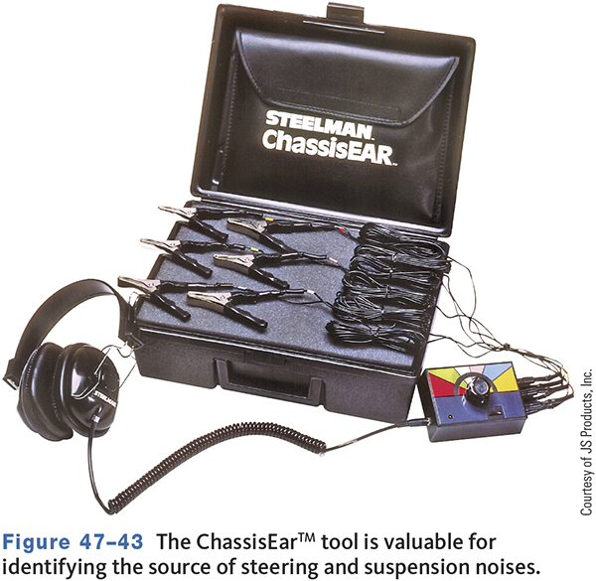
An Electronic Noise Detection Tool

Slide 27
Visual Inspection
Check the tires first
  Pressure, size, construction, wear, damage, defects, runout, and balance.
Power steering drive belt.
Power steering fluid.
Fluid leaks.

Slide 28
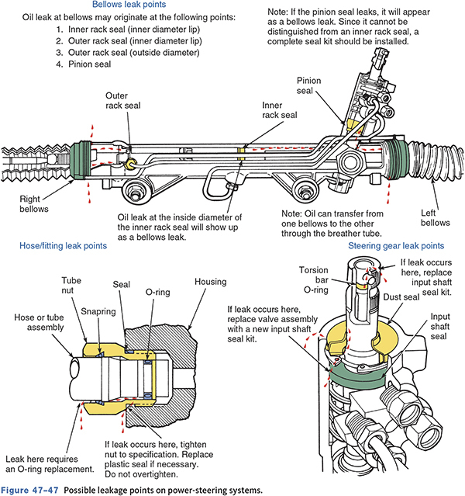
Power Steering Leak Points

Slide 29
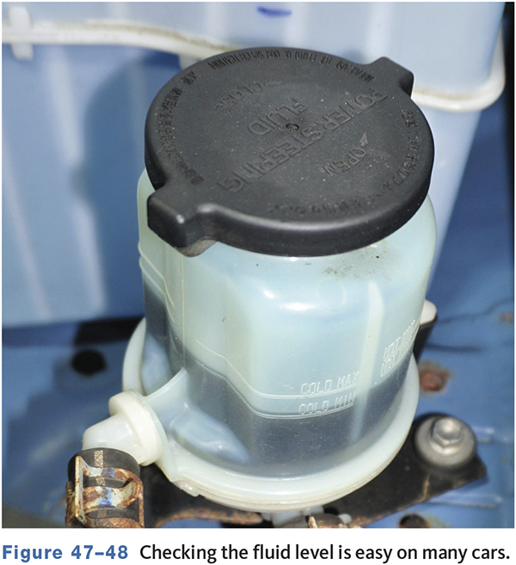
Power Steering Fluid
Can be checked hot or cold.
Most systems allow the fluid to be checked by examining the reservoir.
Some manufacturers recommend specific power steering fluids.
Check color, odor, and for signs of metal content.

Slide 30
Power Steering Pressure Checks
Most late model vehicles have a P/S pressure sensor that can be monitored via a scan tool.
A P/S pressure test gauge can be used.
Always follow the manufacturers testing procedures.
Do not hold the steering against the stops for more than 3–5 seconds.

Slide 31
Electric Power Steering System Testing
Don’t forget to check for TSB’s and recalls.
Testing is performed with a scan tool.
In some cases, power assist will be disabled, but manual steering will still work.
Problems can arise from the steering motor, speed sensor, or control unit.
If the motor gets too hot, the control module may reduce current flow which increases effort.

Slide 32
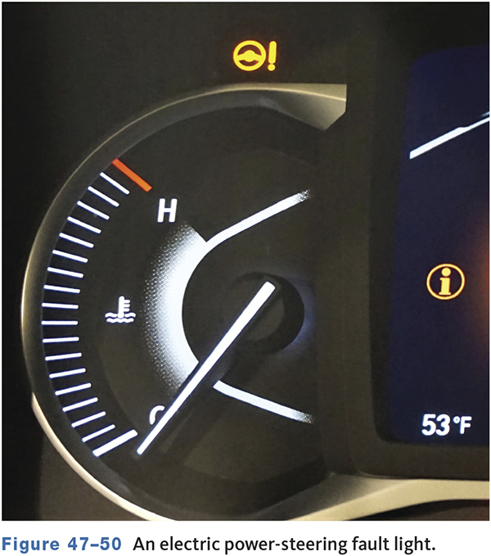
Electric Power Steering (EPS) Fault Light
Comes on when a problem is detected.
A DTC is set when light is on.
In most cases, no power steering is available.

Slide 33
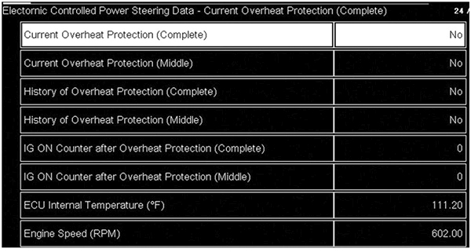
EPS Scan Testing

Slide 34
Recirculating Ball System Checks (1 of 2)
47.05 Inspect and service steering linkage components.
A worn or damaged idler arm can cause steering instability, uneven tire wear, front-end shimmy, hard steering, and excessive play.
A worn or damaged center link can cause front-end shimmy, pull, changes in toe, and tire wear.
Worn tie-rods result in incorrect toe, scalloped and scuffed tires, wheel shimmy, understeering, noise, and tire squeal on turns.

Slide 35
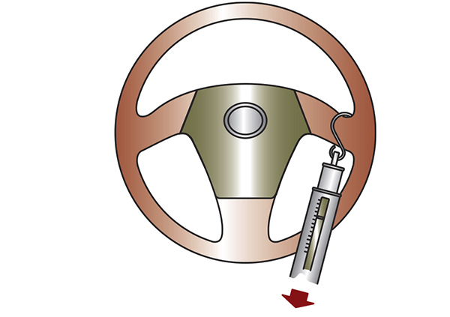
Recirculating Ball System Checks (2 of 2)
Dry park check.
Turning effort.
Tie rod articulation effort.

Slide 36
Knowledge Check (3 of 3)
Which of the following can cause hard steering?
  Low power steering fluid level
  Loose power steering belt
  Worn tie rod
  All of the above

Slide 37
Knowledge Check Answer (3 of 3)
Which of the following can cause hard steering?
  Low power steering fluid level
  Loose power steering belt
  Worn tie rod
  All of the above
  Answer: B. Loose power steering belt

Slide 38
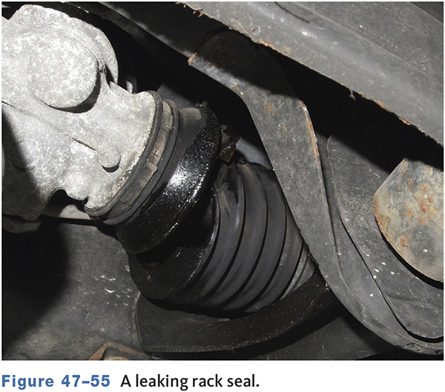
Rack and Pinion Steering Checks
Power rack and pinion assemblies should be carefully checked for leaks.
Check for torn or damaged rack boots.
Rack and pinion steering inspection must be very thorough because of the system’s sensitivity.

Slide 39
Steering System Servicing
47.06 Inspect and service power steering components.
Tie rod replacement is a common service.
Inner tie rods require a special tool to remove and install.
Do not reuse nylon lock nuts.
Do not reuse cotter pins.

Slide 40
Electrically Assisted Rack and Pinion Service
Replacing an electrically assisted rack is similar to replacing a hydraulic unit.
Check all electrical connections
  A loose terminal or connection can lead to overheating and damage to the unit.
In most cases in the aftermarket, a complete rack will be installed.
  At the dealership when handling warranty concerns, individual components may be replaced.

Slide 41
Steering Columns
Most services are performed with the column installed in the vehicle.
Closely inspect the energy absorbing sections of the column.
Inspect couplers and steering shaft.

Slide 42
Steering Wheels
Place front wheels straight ahead.
Disconnect battery negative cable.
Remove steering pad (Air Bag) and retaining nut
  WARNING: The center of the steering wheel contains the driver side air bag. Failure to disarm it can cause serious personal injury.
Place alignment marks on shaft and wheel.
Disconnect electrical connectors.
Use correct puller and remove wheel.

Slide 43
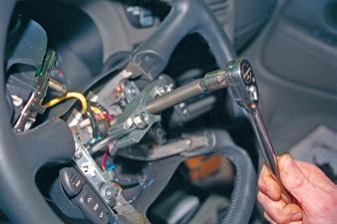
Steering Wheel Puller

Slide 44
Bleeding the System
Performed after replacing any system hydraulic part.
Follow service manual procedures.
A vacuum pump can be used to purge air.
Often running the engine and turning the steering from stop to stop will remove the air.

Slide 45
Electric Power Steering Systems
The motor must be positioned properly to provide assist.
Mark steering shaft before removing.
Systems with a torque sensor must be recalibrated to zero after some component replacement or there is a difference in steering effort.

Slide 46
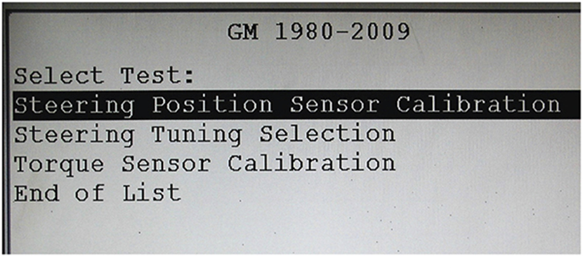
EPS Calibration

Slide 47
Hoses and Lines
Inspect for leaks, dents, sharp bends, cracks, and swelling.
Use exact replacements.
Do not attempt to patch or repair.
Ensure lines and hoses do not rub against other components.

Slide 48
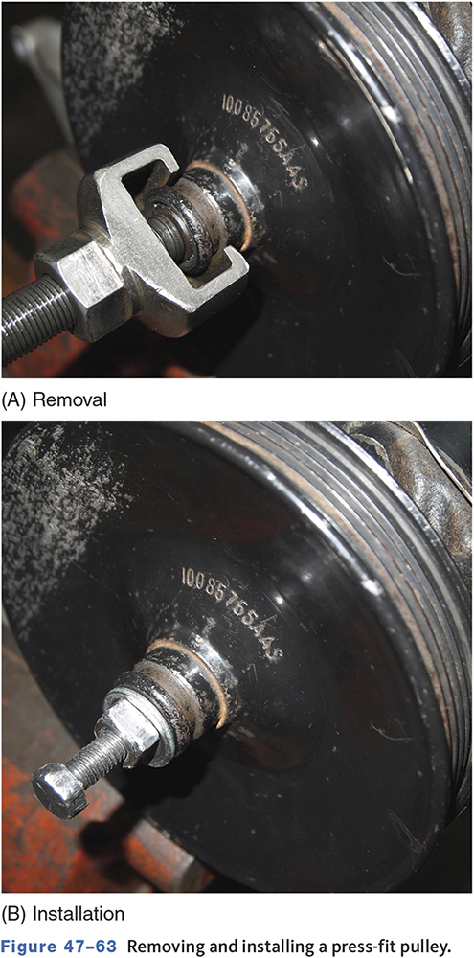
Power Steering Pump
Pulleys may be replaced if bent, cracked, or worn.
Some require special pullers and installation tools.
Flow control valves and pressure relief valves may be replaceable.

Slide 49
Four-Wheel Steering Systems
47.07 Describe the components and operation of four-wheel steering systems.
Are not very common.
Hydraulic 4WS
  Rear wheels turn in same direction as the front.
Electro/Hydraulic 4WS
  Rear wheels can turn with or opposite front.
  Uses computer monitoring and control.

Slide 50
Four-Wheel Steering Advantages
The vehicle’s cornering behavior becomes more stable and controllable at high speeds.
The vehicle’s response to steering input becomes quicker and more precise.
The vehicle’s straight-line stability at high speeds is improved.
Stability in lane changing at high speeds is improved.
By steering the rear wheels in the direction opposite the front wheels at low speeds, the vehicle’s turning circle is greatly reduced.

Slide 51
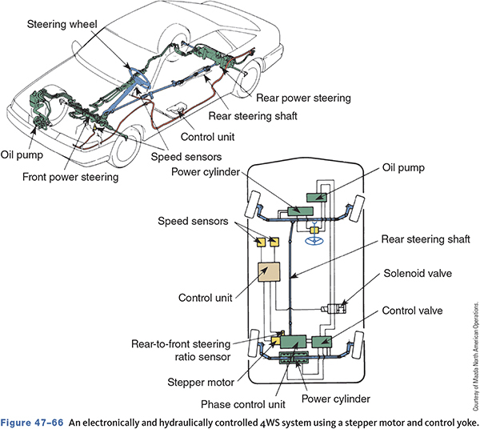
Electronically and Hydraulically Controlled 4WS system

Slide 52
Chapter Reflection
Describe the concept or system from this chapter that challenged you the most.
Describe what made the concept difficult for you and the steps you took to improve your understanding.
How could you help another learner who was struggling with the same concept.
Use 100–150 words in your answer.

